Slide 1
Ukkonen’s Algorithm
Group #6
Sindhuja Gudi 999992808
Anitha Gonuguntla 999992828
Ram Sudheer 999991953

Slide 2
Construction of suffix tree using Ukkonen's algorithm
Ukkonen’s algorithm was developed in 1995.
Ukkonen's algorithm is also referred as linear algorithm.
This on-line algorithm was developed to reduce the processing from O(n²) to O(n).

Slide 3
Applications :
Suffix trees are used to find repetition of longest substring
To find lengthiest common substring
To find lengthy palindrome in a string
Depth of the substring

Slide 4
Rules
Walk through the path add new character at the end.
If there is no path with certain label, create a leaf node.
If the path already exists, then we don't have to do anything.

Slide 5
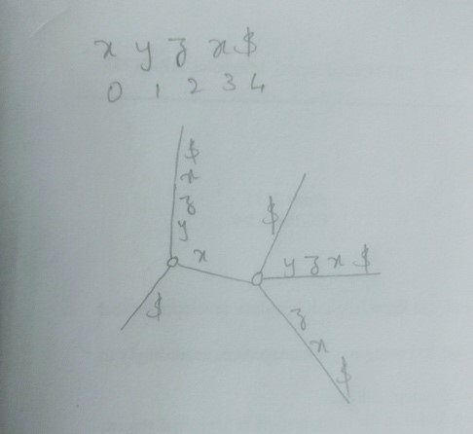
After applying above mentioned 3 rules suffix tree looks like the following

Slide 6
Tricks
Skip count and edge label compression
Rule 3 extension is a show stopper
Global end for leaves

Slide 7
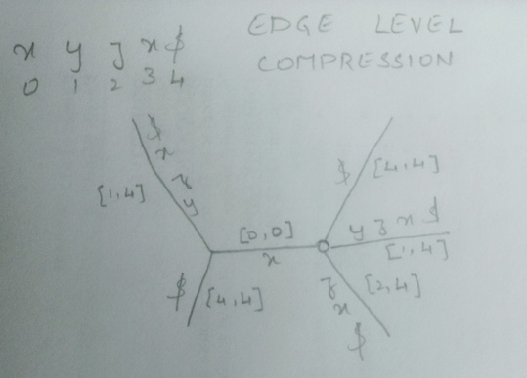
Example
XYZX$

Slide 8
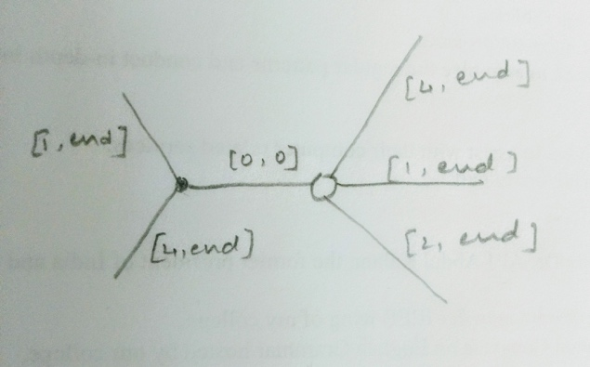
Converting O(n³) time into linear O(n)

Slide 9
Suffix links
For any internal node ‘A’ with path ‘t𝜶’, there is another internal node ‘sv’ with 𝜶 which is suffix link of ‘v’. If 𝜶 is null, then the suffix link is root. Here, t holds a single element where 𝜶 varies from 0 to infinity.

Slide 10
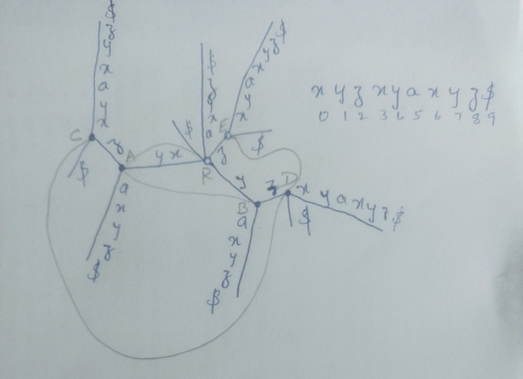
Example: String xyzxyaxyz$

Slide 11
Active points
Active node: root
Active edge: -1
Active length 0

Slide 12
Pros and Cons
Reduce the time complexity to O(n) from O(n²) and O(nlogn).
Cannot reduce it to O(1)

Slide 13
Thank you

